Slide 1

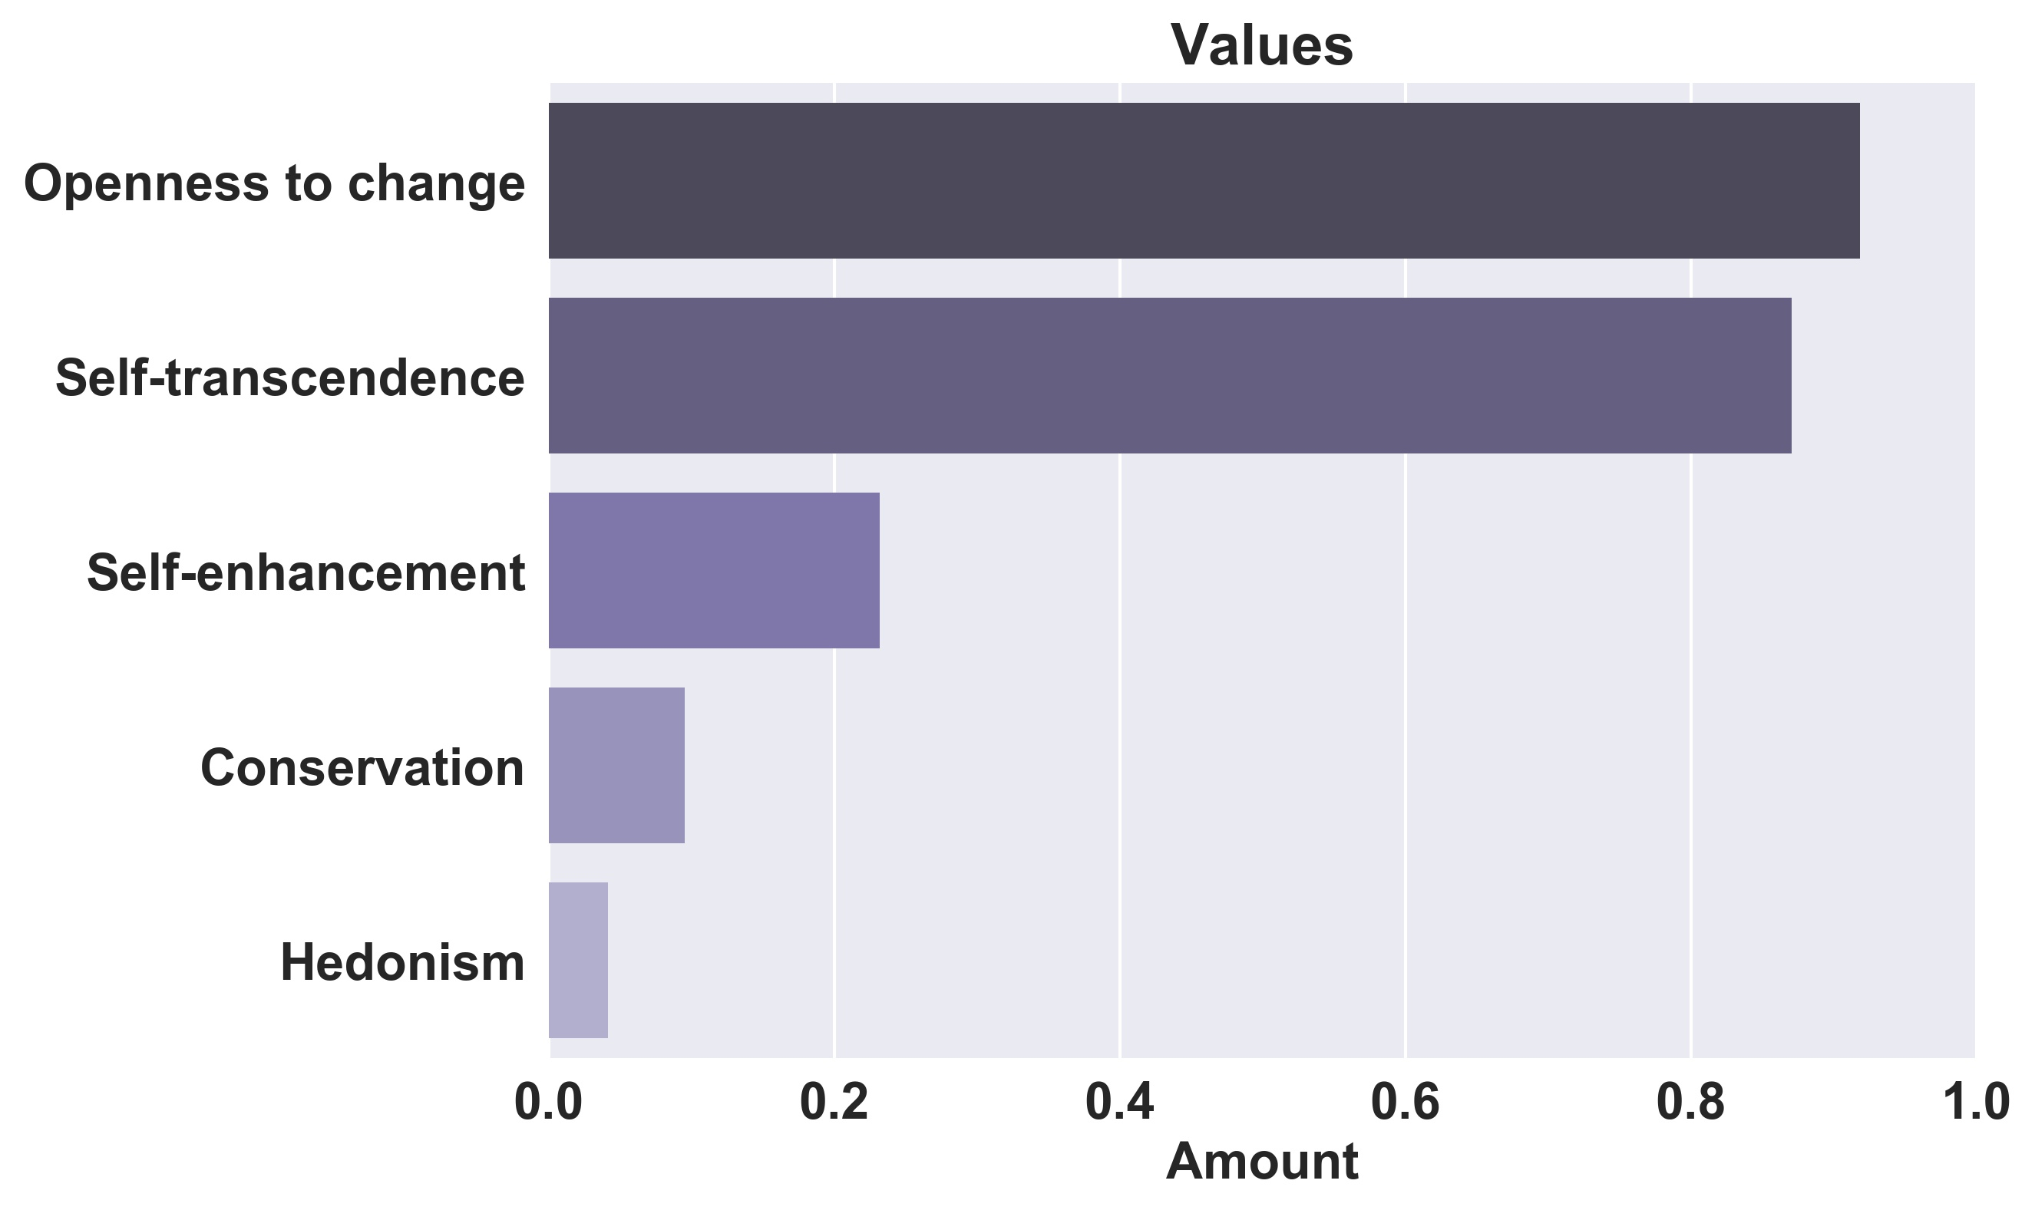
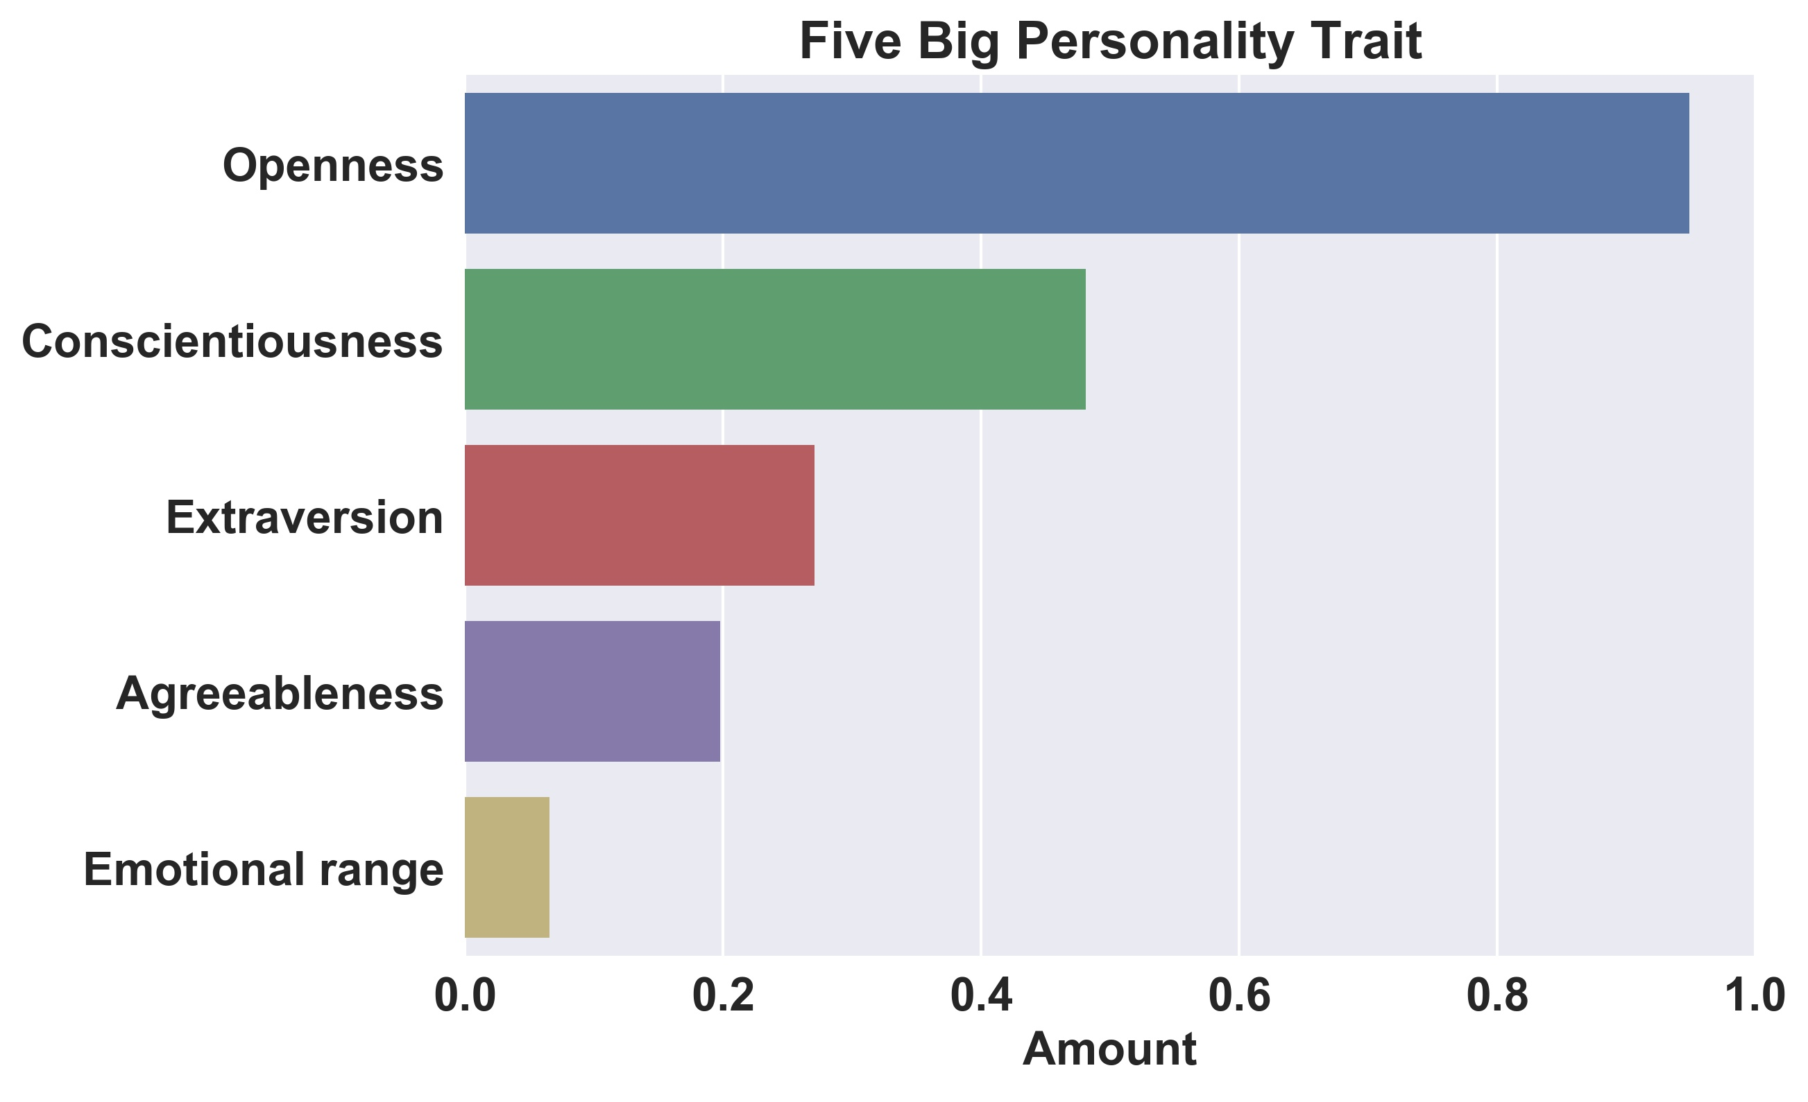
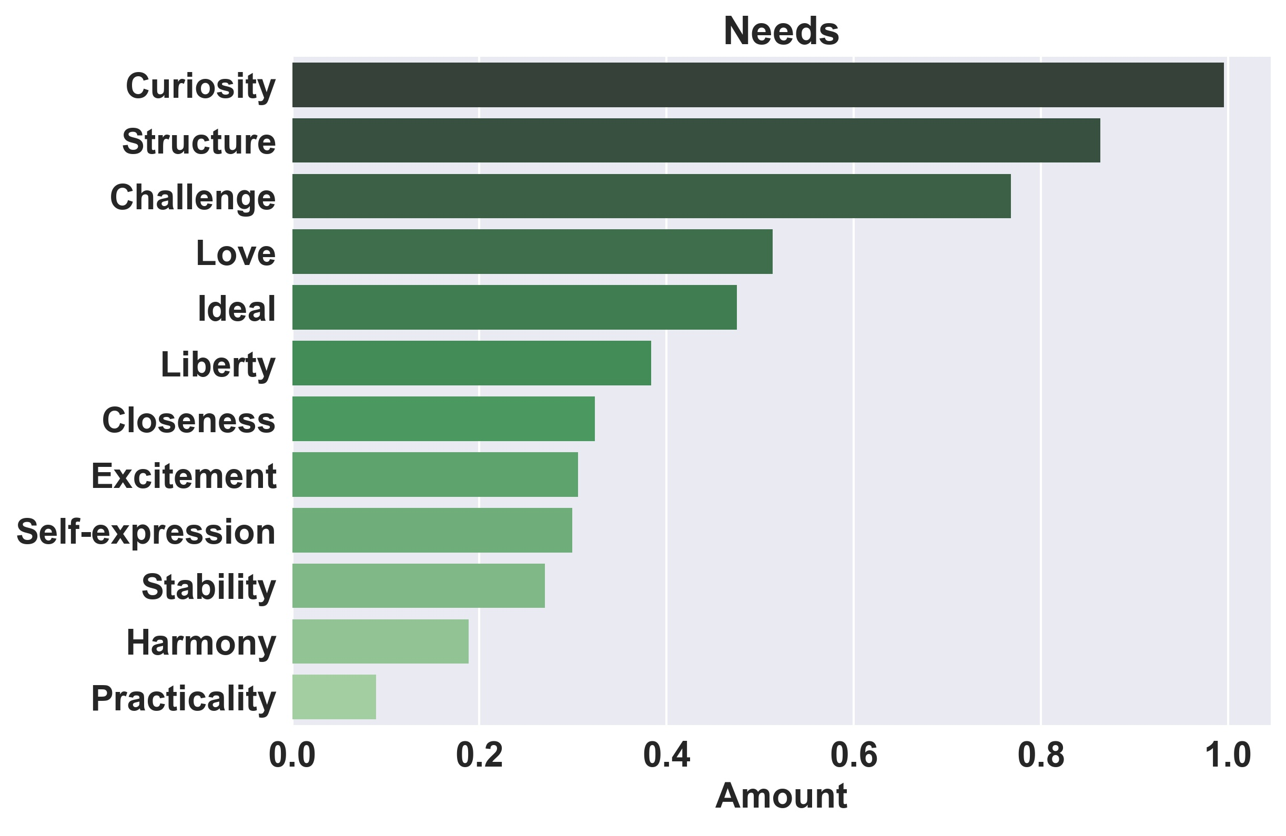
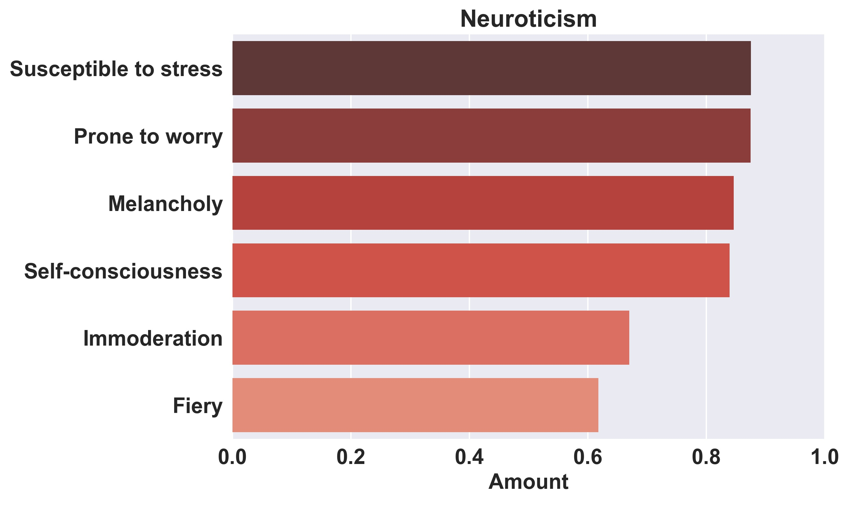
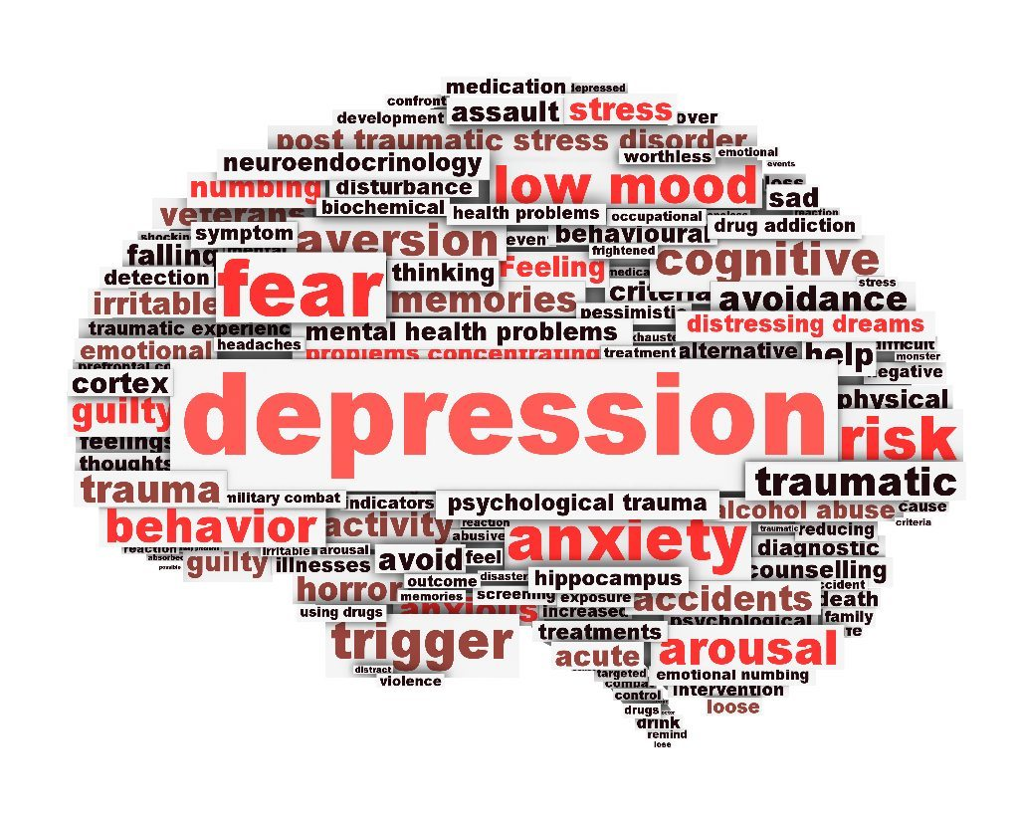
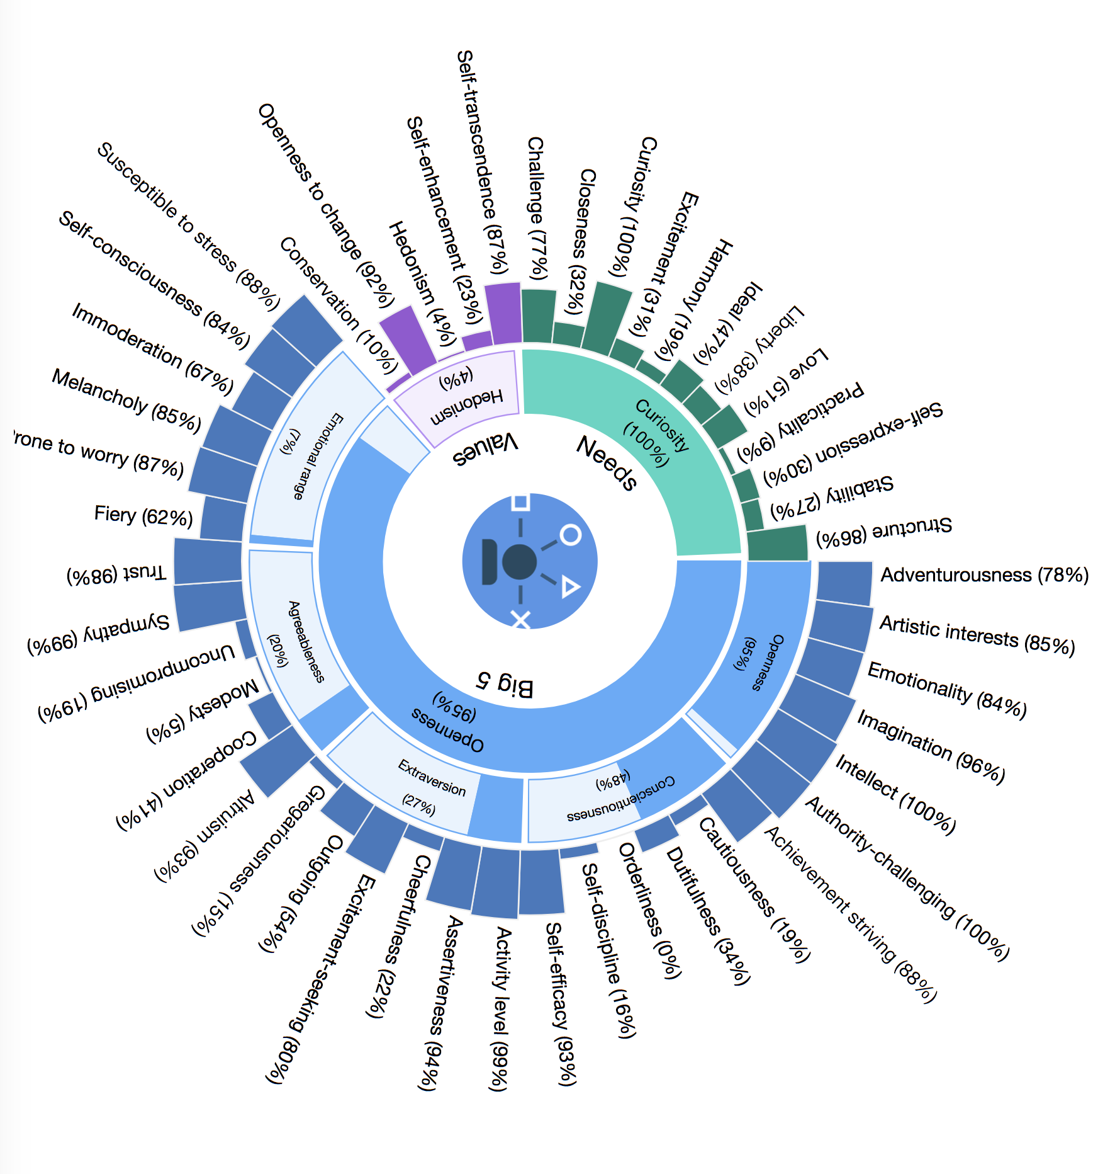
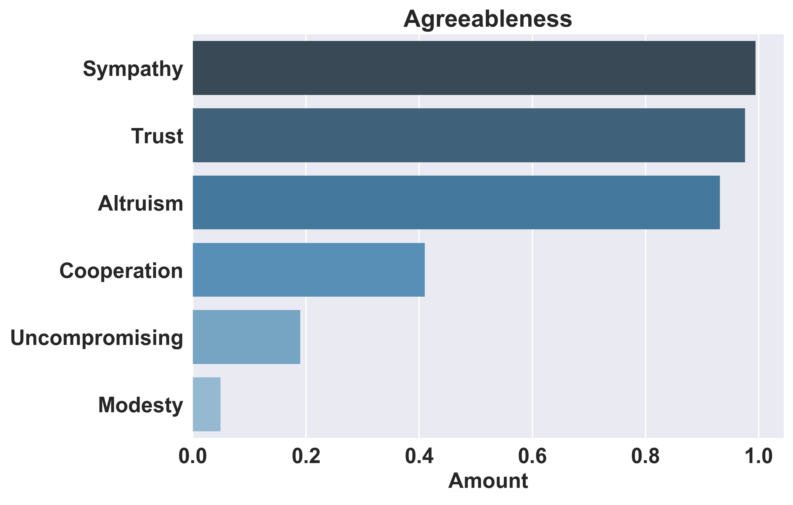
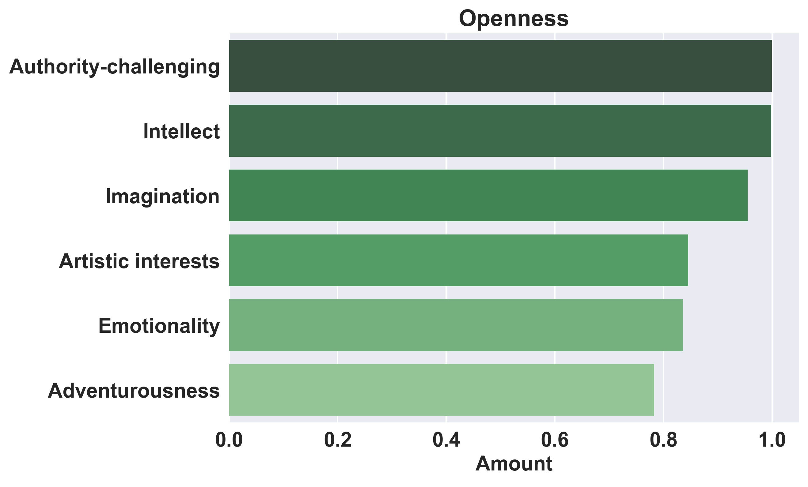
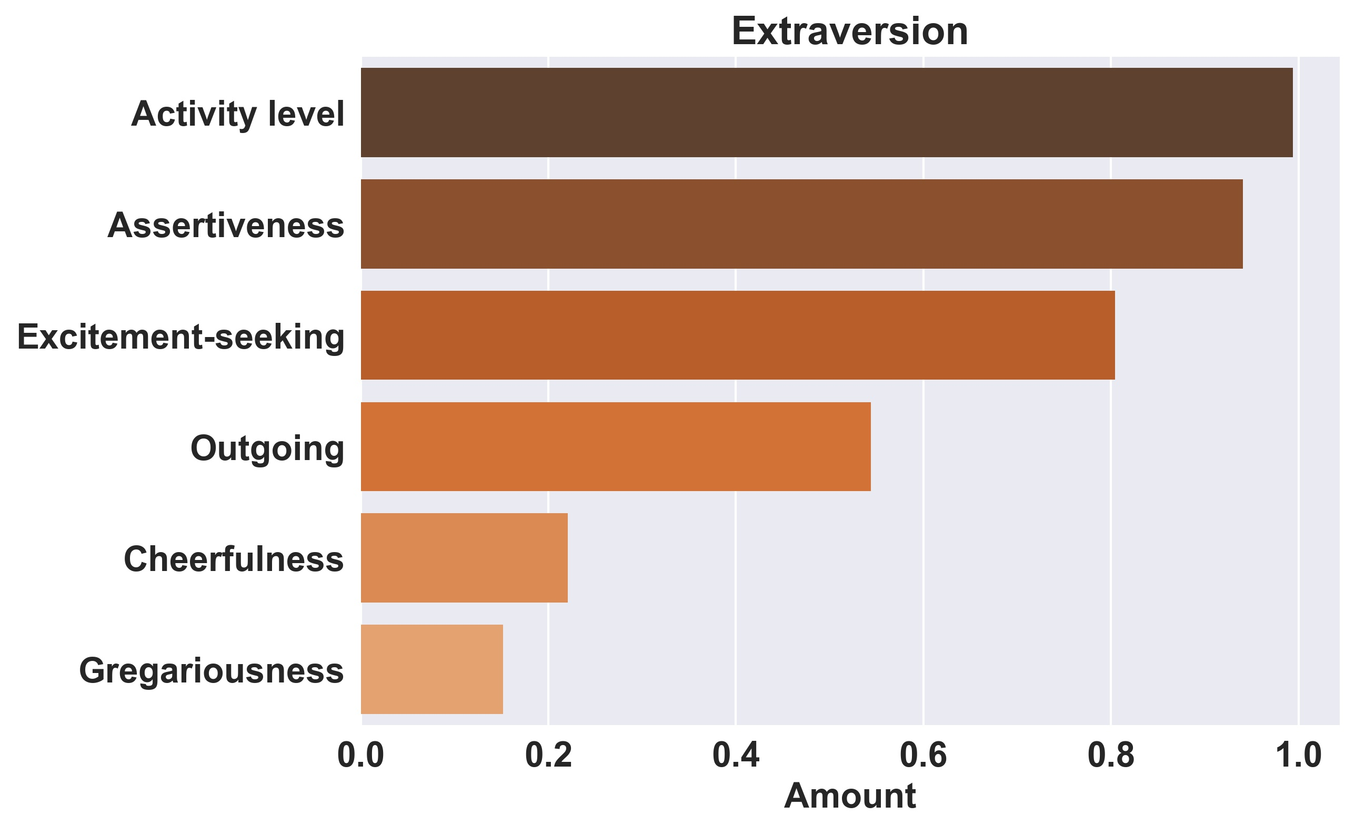
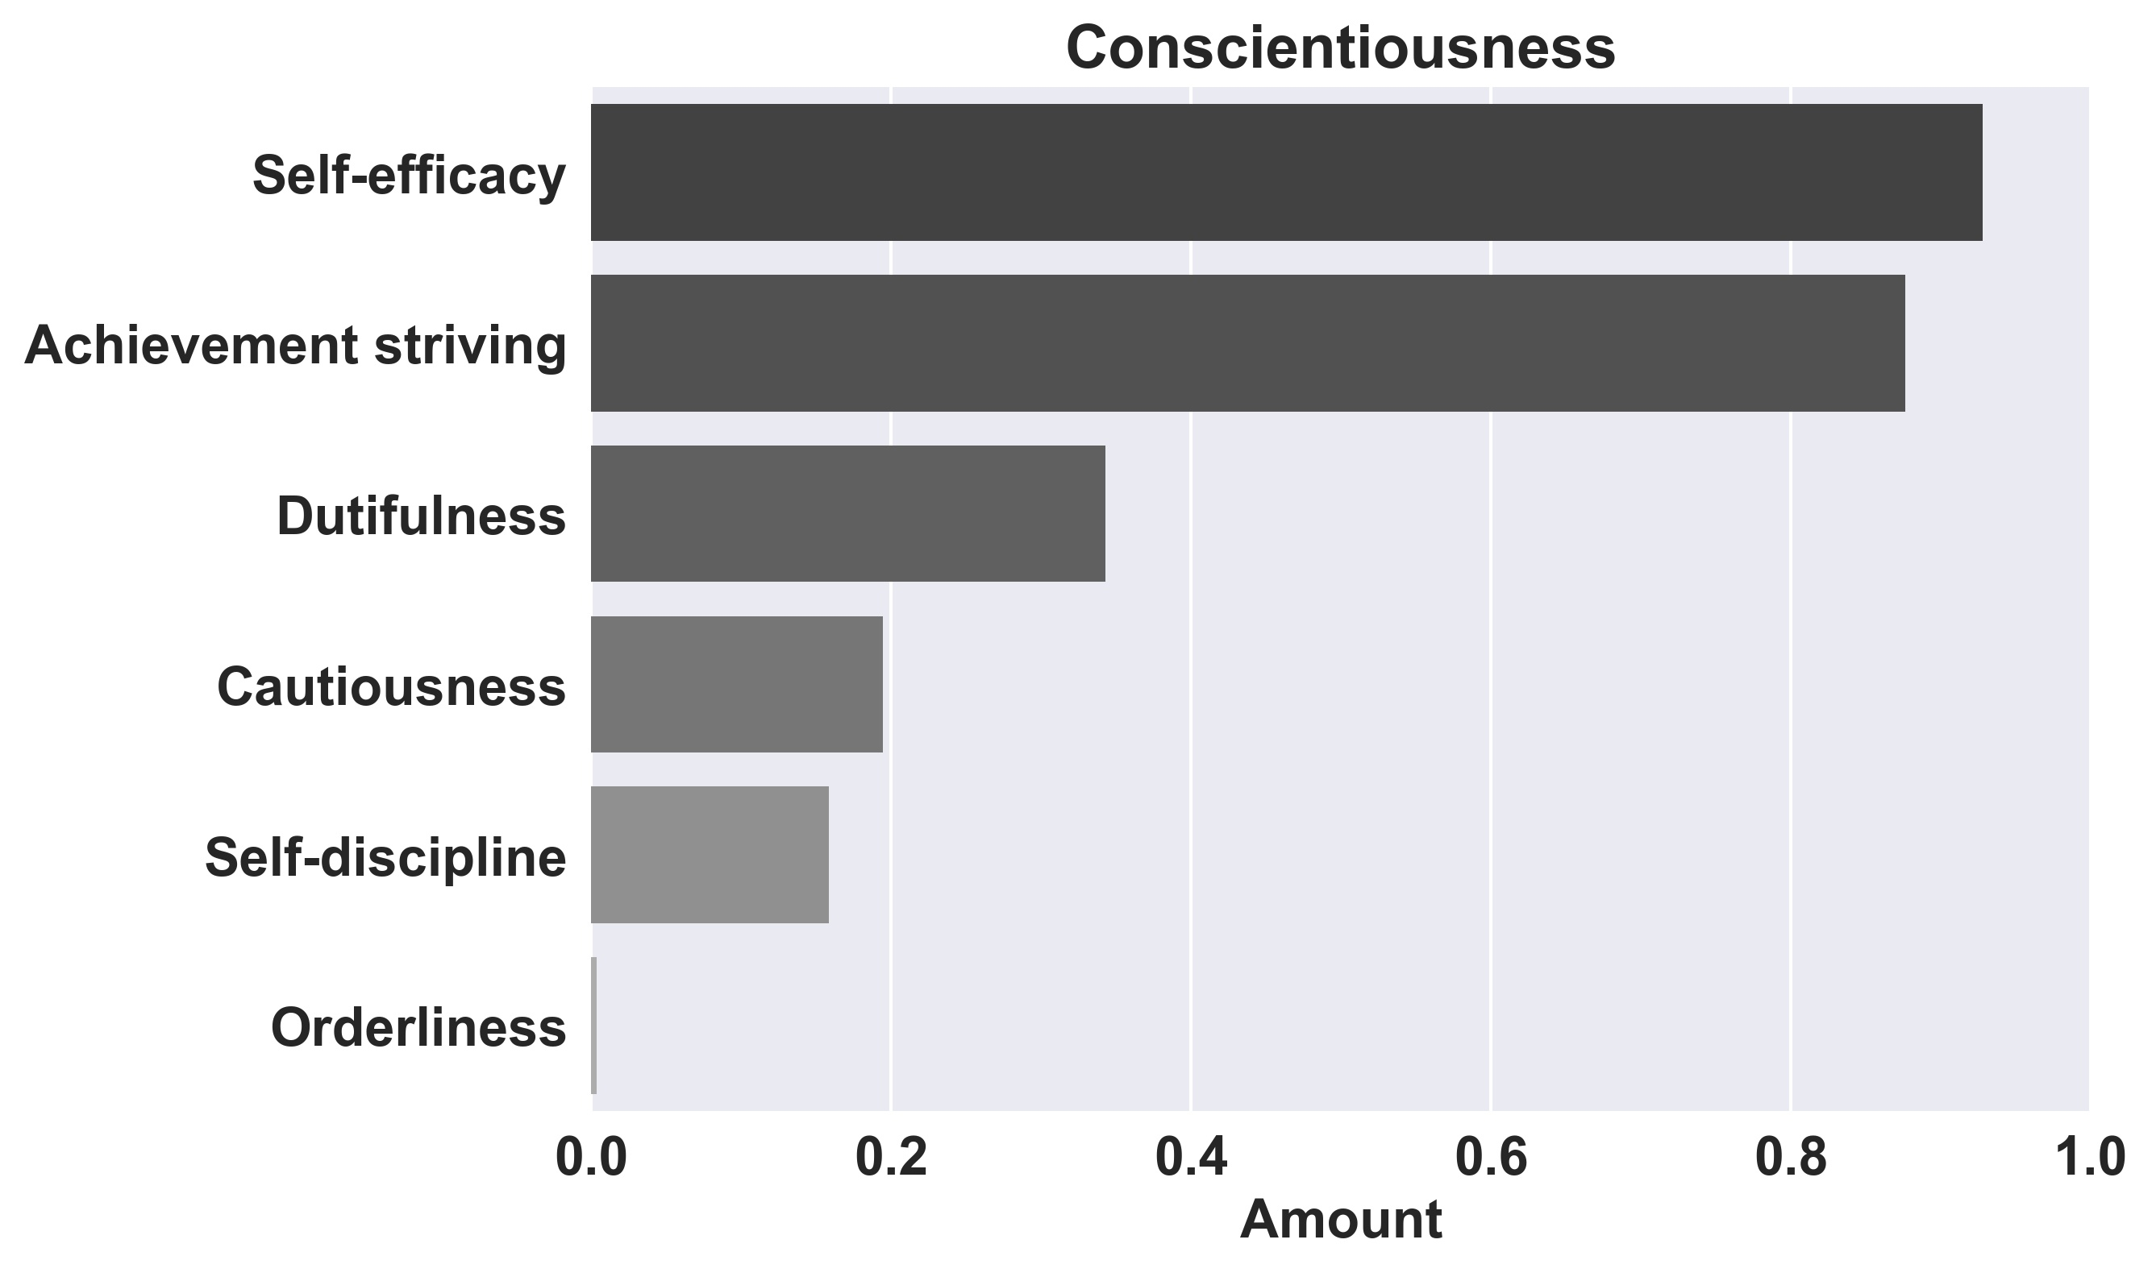


Mental Health Prediction using Sentiment Analysis By Salman Sigari, Pouria Babvey Supervisor: Professor Chris Asakiewicz
Business Intelligence & Analytics
What is a Major Depressive Disorder?
Millions of people each year suffer from depression and only a fraction receives suitable treatment. Mental illness is a leading cause of disability worldwide. It is estimated that nearly 300 million people suffer from depression (World Health Organization, 2001). One of the most common mental illness is Major Depressive Disorder (MDD). MDD is characterized by episodes of all-encompassing low mood accompanied by low self-esteem, and loss of interest or pleasure in normally enjoyable activities. It is also well-established that people suffering from MDD tend to focus their attention on unhappy and unflattering information, to interpret ambiguous information negatively, and to harbor pervasively pessimistic beliefs (Kessler et al., 2003; Rude et al., 2004).
5 big personality traits
This service provide a personality insight based on a written text (600 words or more)
Project Goal and Instruction
Recent studies show that social media contains useful signals for characterizing the onset of depression in individuals, as measured through a decrease in social activity, raised negative affect, highly clustered egonetworks, heightened relational and medicinal concerns, and greater expression of religious involvement. We apply Natural Language Processing (NLP) to diagnose MDD in individuals by using social media posted by users through social media such as Twitter, Facebook or even daily email communications. It would be done by compiling the source of Twitter accounts who have reported being diagnosed with clinical depression. We measure behavioral attributes relating to social engagement, emotion, language and linguistic styles, ego network, and mentions of antidepressant medications. Then, we build a statistical classifier by leveraging these behavioral cues to provides estimates of the risk of depression, before the reported onset.
Big 5 personality Traits
The “personality insight” service of IBM Watson platform uses sentiment analysis to provide a broad range of emotional metrics including 5 big personality traits. We can easily feed the service with tweets, self-statements, talks, and etc to draw these key parameters.
We used deep learning to extract personality disorders
To our knowledge the idea is totally new.
Conclusion
The findings represented that individuals with lowered social activity, greater negative emotion, high self-attentional focus, increased relational and medicinal concerns, and heightened expression of religious thoughts are highly suspicious to MDD. They also appeared to belong to highly clustered close-knit networks and were typically highly embedded with their audiences, in terms of the structure of their egonetworks.
Modeling & Results
Classification Prediction Accuracy- different algorithms generated widely varying accuracy results
References:
De Choudhury, Munmun, et al. "Predicting Depression via Social Media." ICWSM 13 (2013): 1-10.
De Choudhury, Munmun, Scott Counts, and Eric Horvitz. "Predicting postpartum changes in emotion and behavior via social media." Proceedings of the SIGCHI Conference on Human Factors in Computing Systems. ACM, 2013.
Israel, Salomon, et al. "Translating personality psychology to help personalize preventive medicine for young adult patients." Journal of personality and social psychology 106.3 (2014): 484.
Krueger, Robert F. "Personality traits in late adolescence predict mental disorders in early adulthood: a perspective‐epidemiological study." Journal of personality 67.1 (1999): 39-65.
http://www.stevens.edu/howe/academics/graduate/business-intelligence-analytics

